Slide 1
Signs of Retaining Wall Failure
Presented by: Calvin Bogart
Drainage & Erosion Manager

Slide 2
Drainage & Erosion Construction
offering a suite of remediation services and design-build capabilities
with our in-house Stormwater
Engineering Division

Slide 3
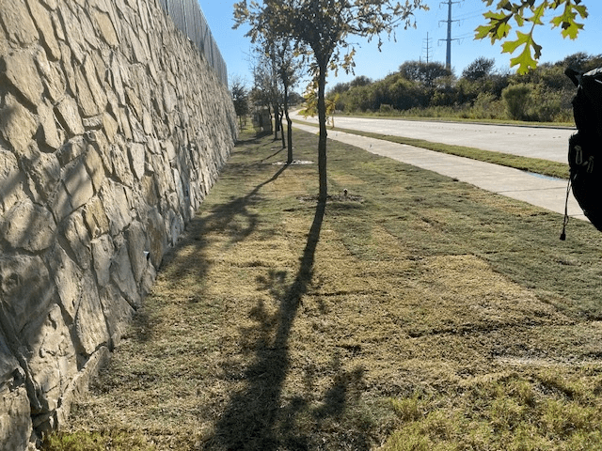
Overview
Information Importance
Signs at Top of Wall
Signs at the Wall Face
Cardinal Construction Solutions
Questions

Slide 4
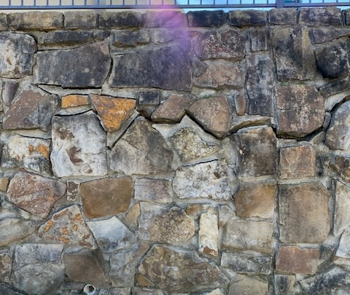
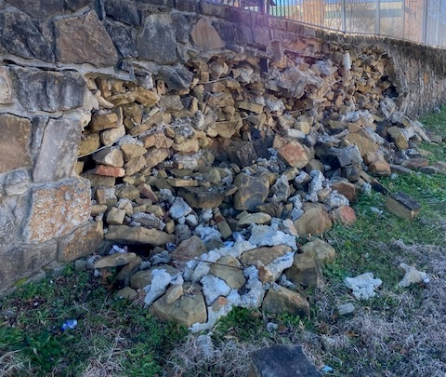
Why is this information important?

Slide 5
If ignored, it can result in structural failure
If caught early, drainage can be installed that prevents wall failure and engineering costs that accompany it

Slide 6
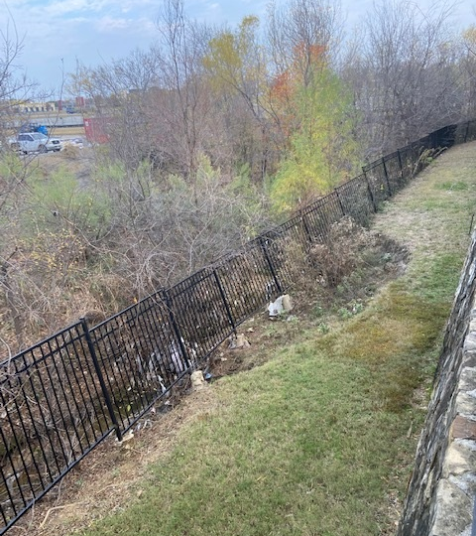
Not all retaining wall issues look like a problem with the wall. Look for bank failures below the wall as well.

Slide 7
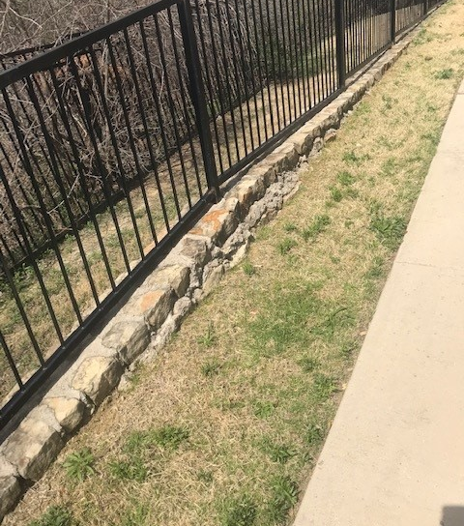
Signs at the Top of the Wall
Exposed rubble behind wall
Vegetation on top indicates no surface erosion
Lack of slope means collecting water goes behind wall

Slide 8
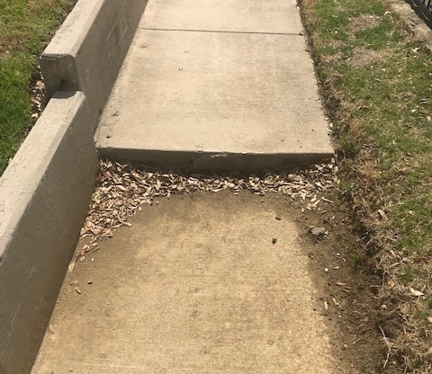
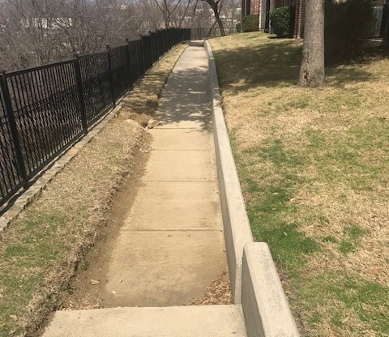
Signs at the Top of the Wall

Slide 9
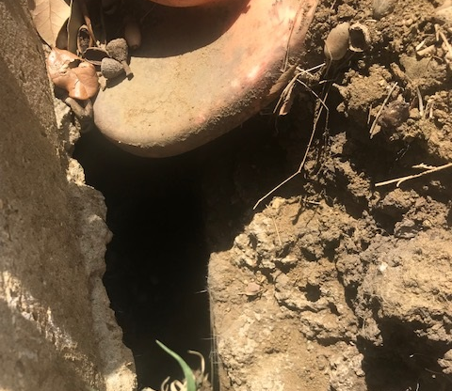
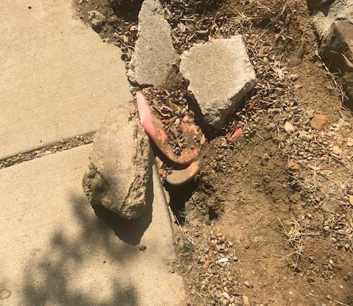
Signs at the Top of the Wall

Slide 10
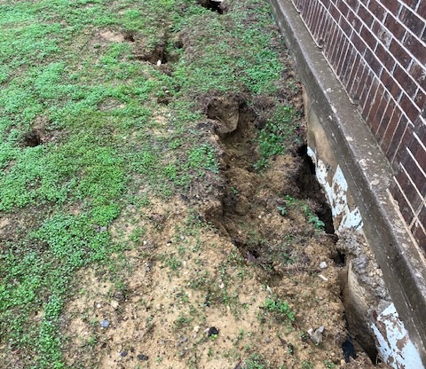
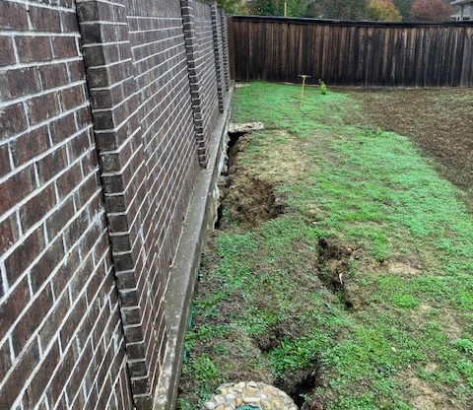
Signs at the Top of the Wall

Slide 11
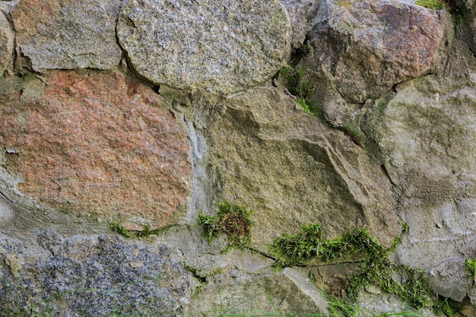
Signs at the Wall Face
Presence of Efflorescence or Moss/Vegetation
Visibly bulging or leaning wall
Cracks and separation along wall

Slide 12
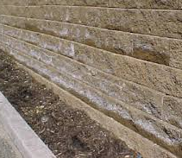
Efflorescence
Moss/Vegetation
Signs at the Wall Face

Slide 13
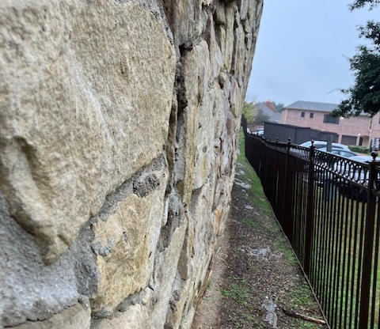
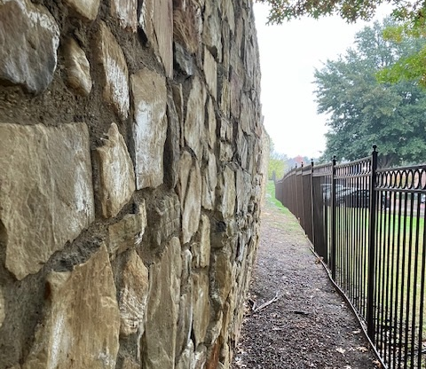
Leaning
Bulging
Signs at the Wall Face

Slide 14
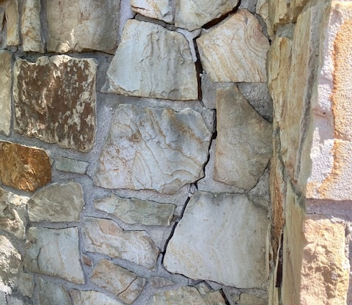
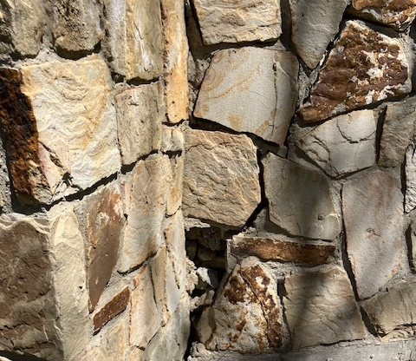
Signs at the Wall Face

Slide 15
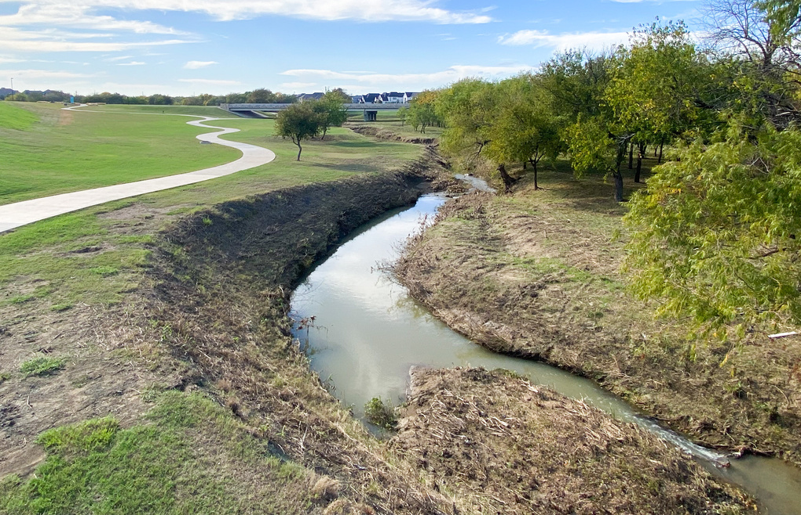
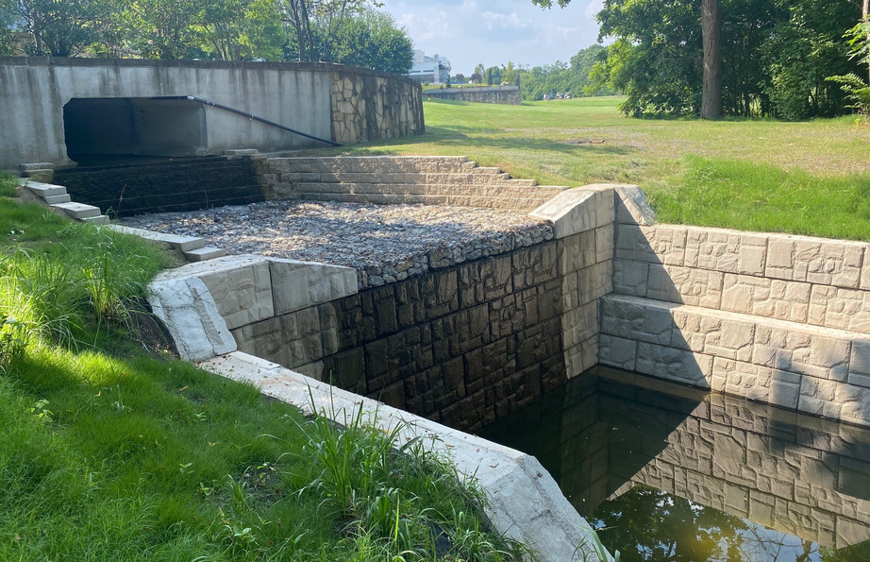
Resilient Drainage Solutions.
Unmatched Expertise.
Schedule your site visit today!
Retaining Wall Repair
Spillway Dam Remediation
Channel Bank Stabilization
Sinkhole Remediation
Drainage Standing Water
Complex Erosion Repair
CARDINALSTRATEGIES.COM

Slide 16
Questions?

