Slide 1
Money Matters

Slide 2
Community Association Banking
Prepare - Have a strategy for your funds

Slide 3


Slide 4
HOA Reserve Fund Investment Rules
Rule #1: Safety Above All Else
Rule #2: Liquidity is a Must
Rule #3: Consider Yield Last

Slide 5

What is FDIC?
What is the FDIC Coverage for an Association?
$250,000
Per Tax ID
Per Banking Institution
Federal Deposit Insurance Corporation
The Federal Deposit Insurance Corporation (FDIC) is an independent agency created by the Congress to maintain stability and public confidence in the nation’s financial system. The FDIC insures deposits; examines and supervises financial institutions for safety, soundness, and consumer protection; makes large and complex financial institutions resolvable; and manages receiverships.

Slide 6

What questions should you be asking when deciding where to put or invest association funds?

Slide 7

How much $ does the association have in their bank accounts?
Review Balance Sheet
Review Income Statement P&L
Review Budget
Review Outstanding Receivables

Slide 8

What Projects are taking place this year of next?
What is the cost of the project(s)?
How much do we currently have for the project?
When will the association need to use these funds for a project?

Slide 9

Has the association done a reserve study?
When does the association anticipate needing funds based on the reserve study.
Will the association need a special assessment or a loan?

Slide 10
Does the association have an investment policy?
What do the association documents say about where and how association funds can be invested?
Where can funds be placed and at what risk?
Consult the association’s attorney about an investment policy if needed.

Slide 11

Where to put or invest association funds?

Slide 12
Certificates of Deposit (CDs)
A certificate of deposit is a type of savings account that pays a fixed interest rate on your deposit for a set period of time (the term), in return for leaving the money in the account untouched for that term length.
Higher Yields
Early withdrawal penalty

Slide 13
Money Market Accounts (MMAs)
A money market account is a type of savings account commonly offered by banks and credit unions. This type of account generally pays interest on your balance and usually allows you to access your money by checks or transfers.
While you can make unlimited deposits, withdrawals and transfers, many times are limited to six (6) transactions per month. Penalties over six (6) transactions can be $25 per item.
MMAs are best for holding savings rather than serving as a day-to-day spending account.

Slide 14
Treasury Products – Bills, Notes and Bonds
US Government Securities
T- Bill Interest does not pay in the traditional sense. Instead, T-Bills are sold at a discount to their face value. When the T-Bill Matures you receive the face value. The difference is your earnings (Interest).
While the secondary market for T-bills is highly liquid, selling before maturity means the final sale price could be lower than the original purchase price, depending on market conditions at the time of sale.
Treasury Bills (T-Bills) | Treasury Notes (T-Notes) | Treasury Bonds (T-Bonds)
Short Term – 4,8, 13, 26 & 52 week maturities | Medium Term – 2 to 10 year maturities | Long Term – maturities 20 & 30 years.

Slide 15

Investment Products
Potential for high yield
Market Risk / Loss of Principal
Breach of Fiduciary Duty
Lack of Insurance
Legal Restrictions
Do you have an investment policy in place?
Mutual Funds
Brokered CDs
Stocks

Slide 16
What is IntraFi
Financial services company
Provides large $ cash management solutions.
Network of 1000’s of banks to spread large deposits across multiple institutions ensuring the full amounts remains protected by FDIC.
It allows associations to work with a single bank, while funds are insured across a wider network.
Products available – CDARs (CDs) and ICS (operating and money market accounts)

Slide 17
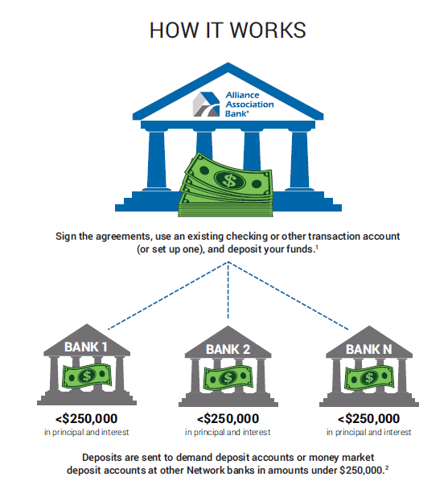

Slide 18
Rate vs APY (Annual Percentage Yield)
 | Interest Rate | APY
What it measures | The basic % of interest you earn on the principal | The total % of interest you would earn in one year, including compounding.
Compounding | Does not include compounding | You earn interest on both your original principal and the accumulated interest.
For Deposit Accounts | Lower than APY because it doesn’t include compounding | Provides a more realistic picture of your total earnings over a year.

Slide 19
HOA Taxes and Reserve Accounts
Reserve Account Yields/Interest could be subject to taxation.
Based on association revenue and other factors interest could be taxed between 21 and 30% depending on filing type.
Work with your CPA and management company to determine what is best for your association.

Slide 20


