Slide 1

Water Conservation in Your HOA
Reducing excessive irrigation without lowering landscape standards

Slide 2
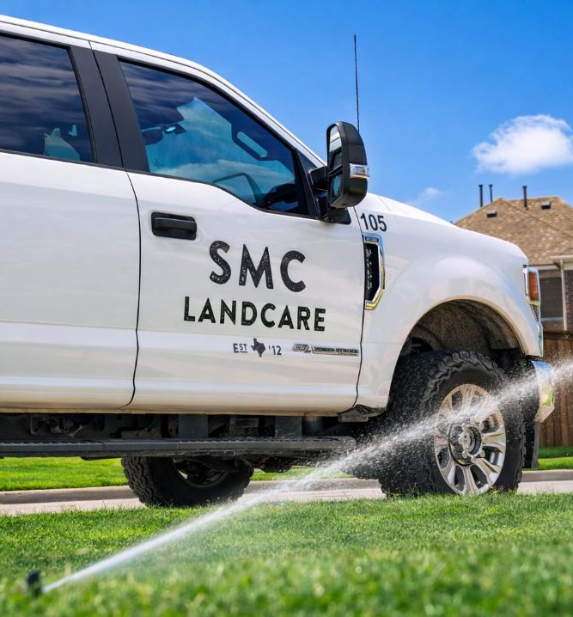

Water Is Typically the Largest Controllable Expense
Average HOA in North Texas
5-15 acres-maintained turf grass
10-20 entrance beds
$50,000-80,000 Annual Irrigation Utility Spend

Slide 3
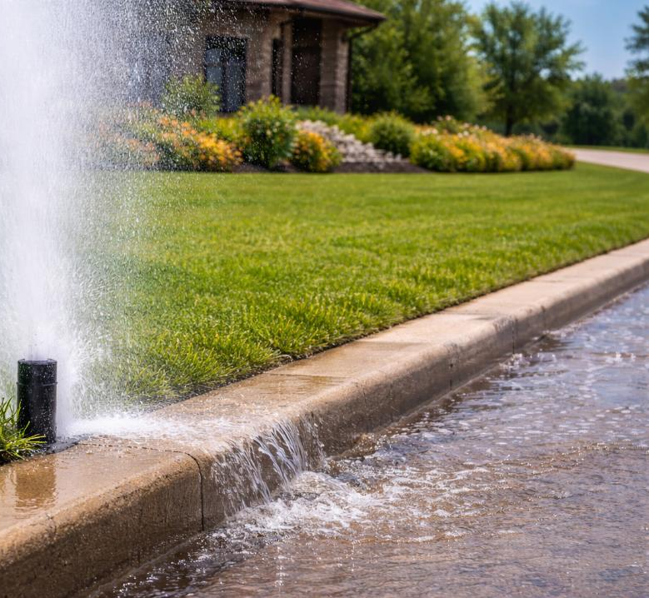
How Water Waste Usually Happens
Water waste is rarely dramatic. It usually comes from:
Overwatering for plant material
Different plants have different watering needs
Pressure issues
Too high
Too low
Programming not adjusted seasonally
Minor leaks left unresolved or unrepaired

Slide 4
Importance of the Irrigation Inspection
What It Establishes
Why It Matters
Performance baseline
Zone-by-zone validation
Proper seasonal programming
Early identification of obvious waste
Proactive vs. Reactive Management
Prevents overuse of resource
Aligns expectations
Reduces utility billing surprises
Sets accountability standard

Slide 5
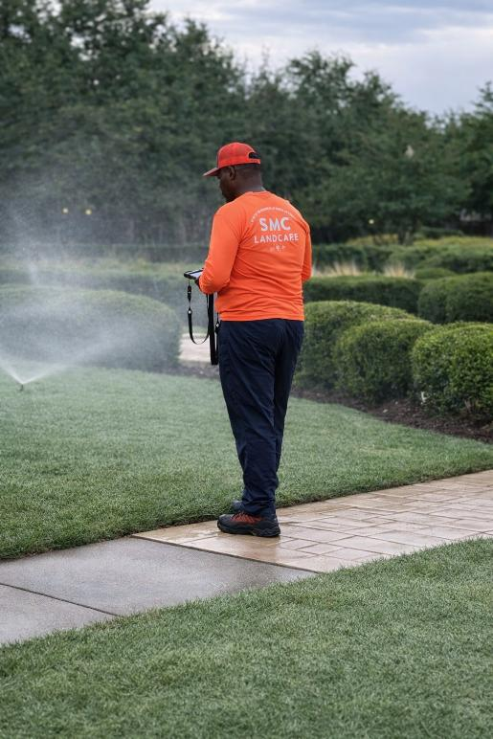
What a True Monthly Irrigation Inspection Includes
Run
Every active zone operated
Coverage observed
Review
Controller programming evaluated
Seasonal adjustments applied
Report
Issues documented
Repairs identified
Visibility provided

Slide 6
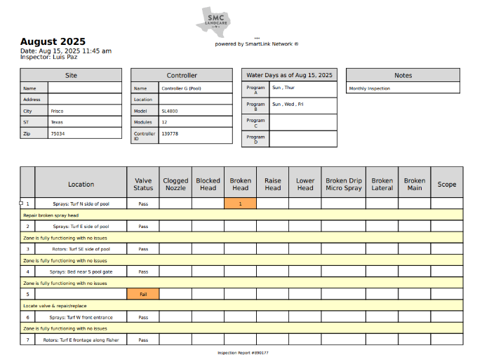
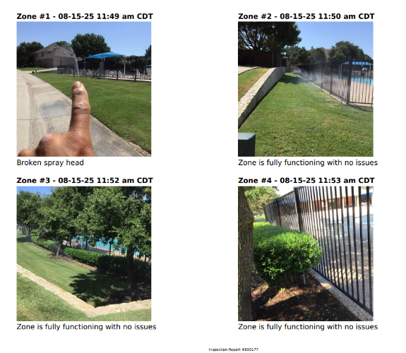
Sample Irrigation Inspection Report

Slide 7
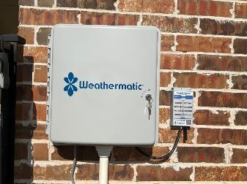
Smart Controllers
What They Do
What They Don’t Do
• Adjust for weather trends • Automate rain/freeze response • Provide remote visibility • Improve scheduling precision
• Replace physical inspections • Fix mechanical issues • Prevent waste if not maintained
Technology supports water management — it doesn’t replace it.

Slide 8
Case Study: Annual Irrigation Spend
49% Reduction (2022-2025)
Same property
Same footprint
No irrigation redesign

Slide 9
3-Year Financial Impact
$73,822
In projected irrigation savings expense over three seasons
Same acreage
Same irrigation system

Slide 10
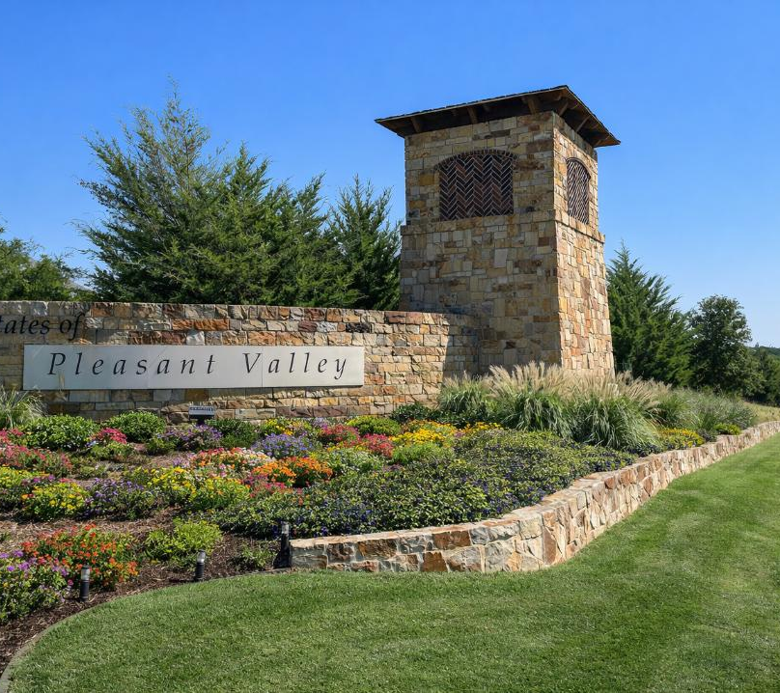
Water Savings Create Budget Flexibility
If $10,000+ per year is recovered, what it can fund?

Slide 11
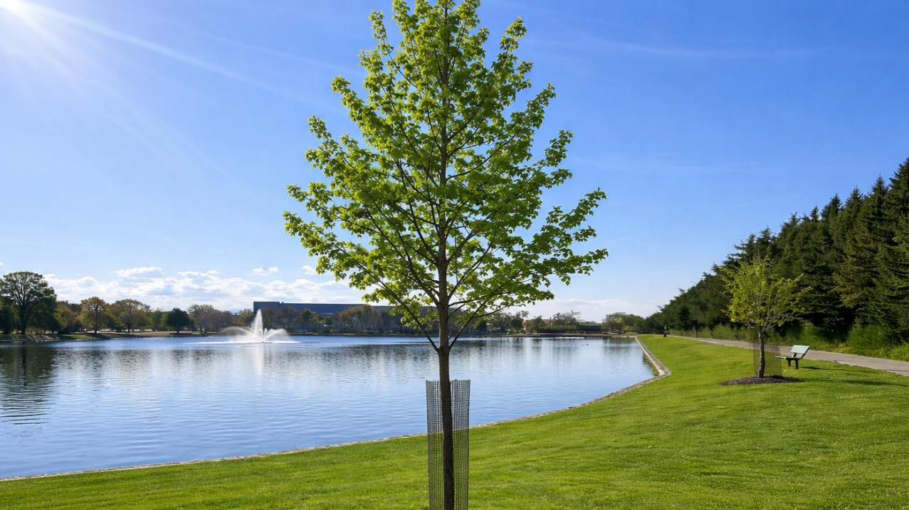
Tree Replacements

Slide 12
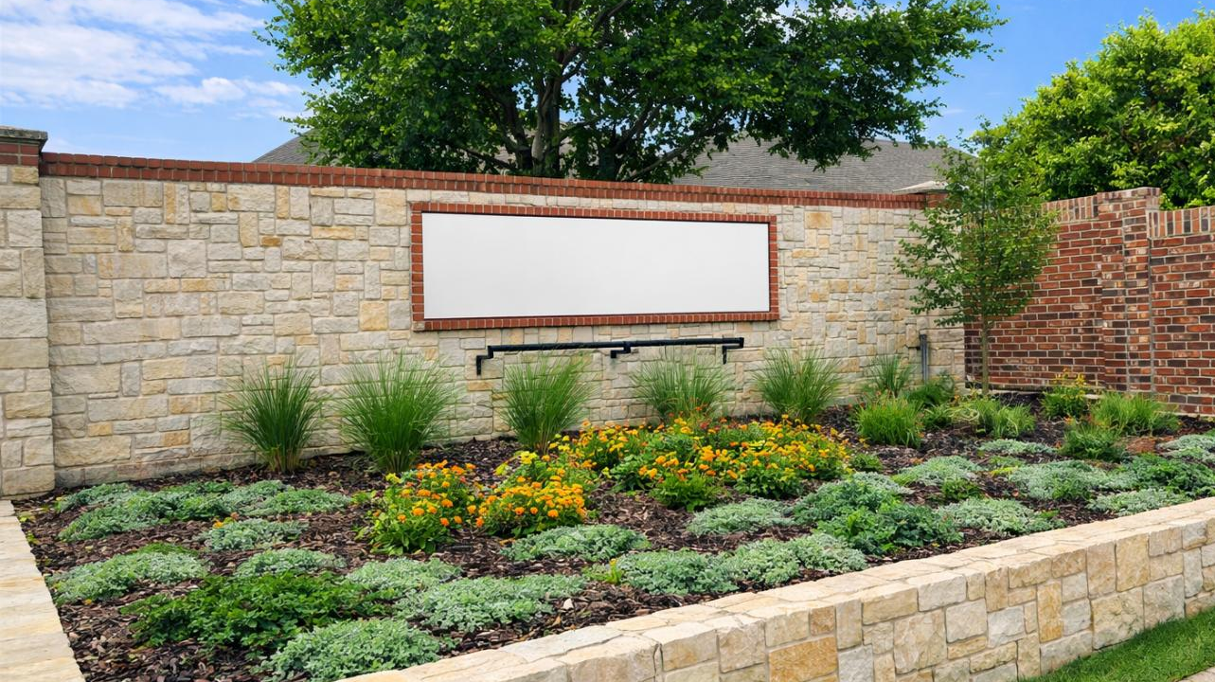
Entry Enhancements

Slide 13
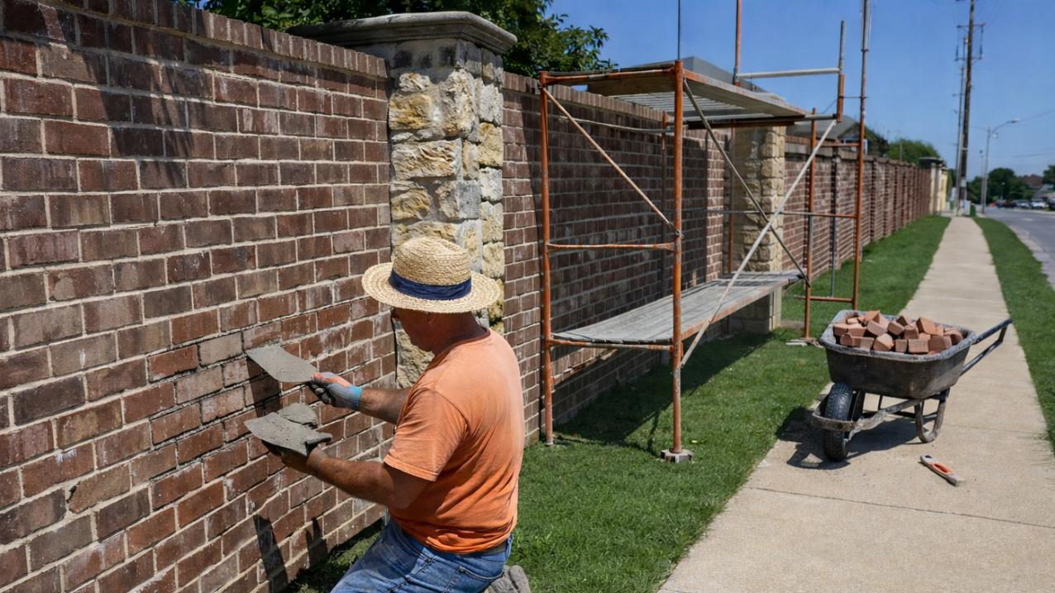
Wall Repairs

Slide 14
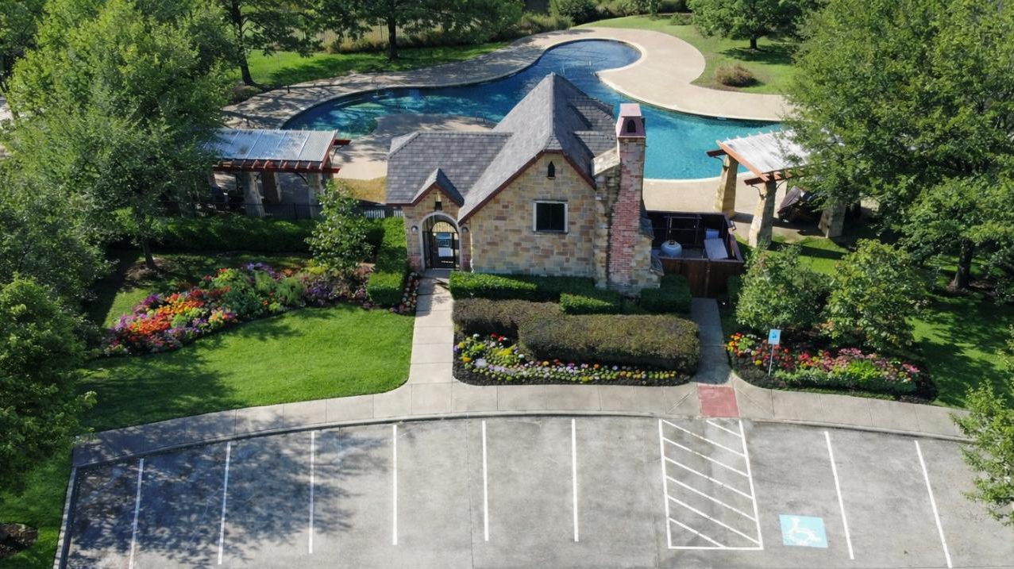
Amenity Centers

Slide 15

Reserve Funds

Slide 16

Water conservation is not about watering less. It’s about managing water intentionally.
Questions & Discussion

Slide 17
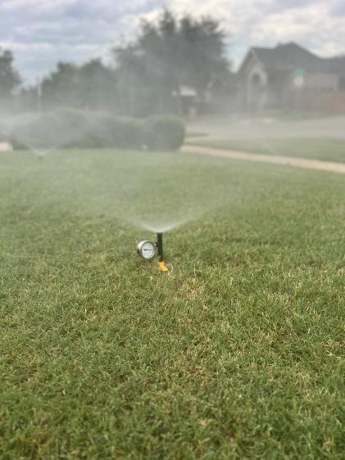
Pressure Correction Case Study
What Was Done
Action Taken
Identified 3 high-pressure irrigation zones
Measured water usage over a 10-minute cycle
Installed pressure-regulated spray heads
Re-tested usage

Slide 18
Pressure Correction Case Study
Financial Impact
Before (10 min cycle) 2,068 gallons
After (10 min cycle) 892 gallons
1,176 gallons saved per 10-minute cycle
If these zones run 3x per week:
≈ 21,000+ gallons saved per month
≈ 250,000+ gallons saved per year
Now convert to dollars conservatively:
At typical North Texas water rates:
≈ $2,000–$4,000 per year From just three zones

